Slide 1
The Movie Database Project
Kennedy Bowers, Zachery Brunner, Jeffrey Cain, Brandon Fisher, Jeremy White

Slide 2
Project Overview
Movie Collection Database - Built in SQL Server Studio 2017
Downloaded and Formatted Data from IMDB
https://www.imdb.com/interfaces/
User Interface built through C# GUIs created to accomplish Use Cases
Languages include C# Visual Studio and SQL Server Studio 2017

Slide 3
Intended Users
Administrative
Add movies, genres, people
Update existing information
Movie Enthusiast
Search movies, people
Run reports

Slide 4
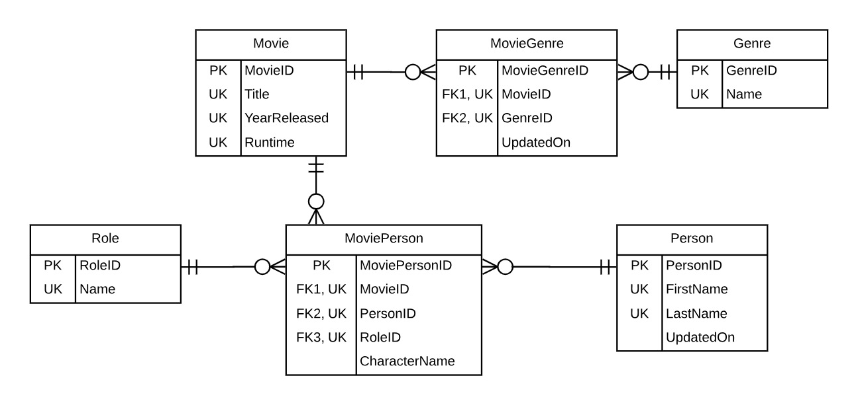
Database Design
Implementation:
Create tables, constraints
Data from Imdb
Populate, reformat
Create stored procedures
Notes:
Brandon

Slide 5
Technical Details
Windows Form Application
C# in Visual Studio 2017
Data formatted from IMDB
Github for Version Control
Notes:
Kennedy

Slide 6
DEMO
Notes:
Kennedy

Slide 7
Future Implementations
User Login - separate Admin access from General access
Add functionality to see theaters and showtimes
Add data, especially more recent movies
Include more information:
Maturity rating: PG, PG-13, R etc.
Box office earnings
Person Info: birthdate, hometown, spouse etc.

Slide 8
Technical Challenges
Formatting IMDB data to fit our database
Using Version Control
Working with SQL and C# communication

Slide 9
QUESTIONS?

